Slide 1



Adaptive Hybrid Intelligent Systems for the Competitive Advantage of Enterprises
Dietrich Rordorf
Olten, 19 May 2023
Emerging Topics in Information Systems, SS 2023

Slide 2
Research Question
What types of competitive advantages can arise out of using adaptive, hybrid AI systems in the editorial process of academic publishers?
AI
Human + AI
Adaptability of AI
Competitive Advantage
Applied to one industry and process

Slide 3
Outline
Adaptive Hybrid AI [slides, video]
Intermezzo: GitHub Copilot [demo]
Competitive Advantage of AI [slides, hands-on, discussion]
Wrap-up [slide, video]

Slide 4
Adaptive Hybrid AI

Slide 5
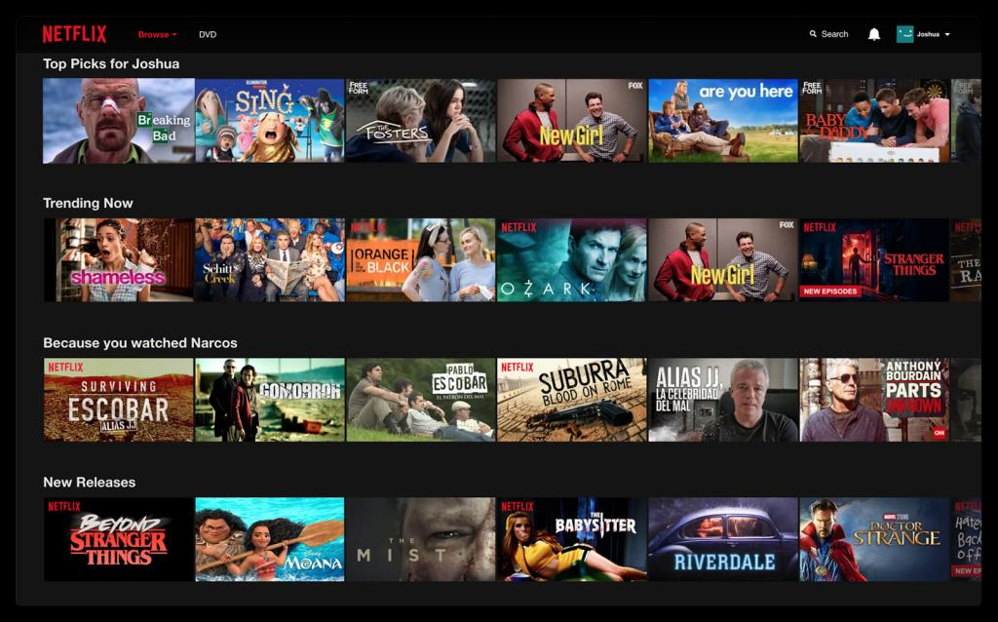

Slide 6
Adaptive AI Systems
Human-aware AI systems should adapt to (based on non-exhaustive literature review):
Adapt to the different needs of different users
Adapt to various user tasks
Adaptability in joint task completion
Adapt to changing environment

Slide 7
Adaptive AI – 1) Different User Needs
Recommender systems, think of Netflix recommendations
Netflix should learn my preferences
Cold-start problem: no data about new user
Data sparsity problem: a lot of data in aggregate, but very few data points for each individual user
Promising hybrid AI approach: graph-learning recommender systems (GLRS) (Zhang et al., 2023)

Slide 8
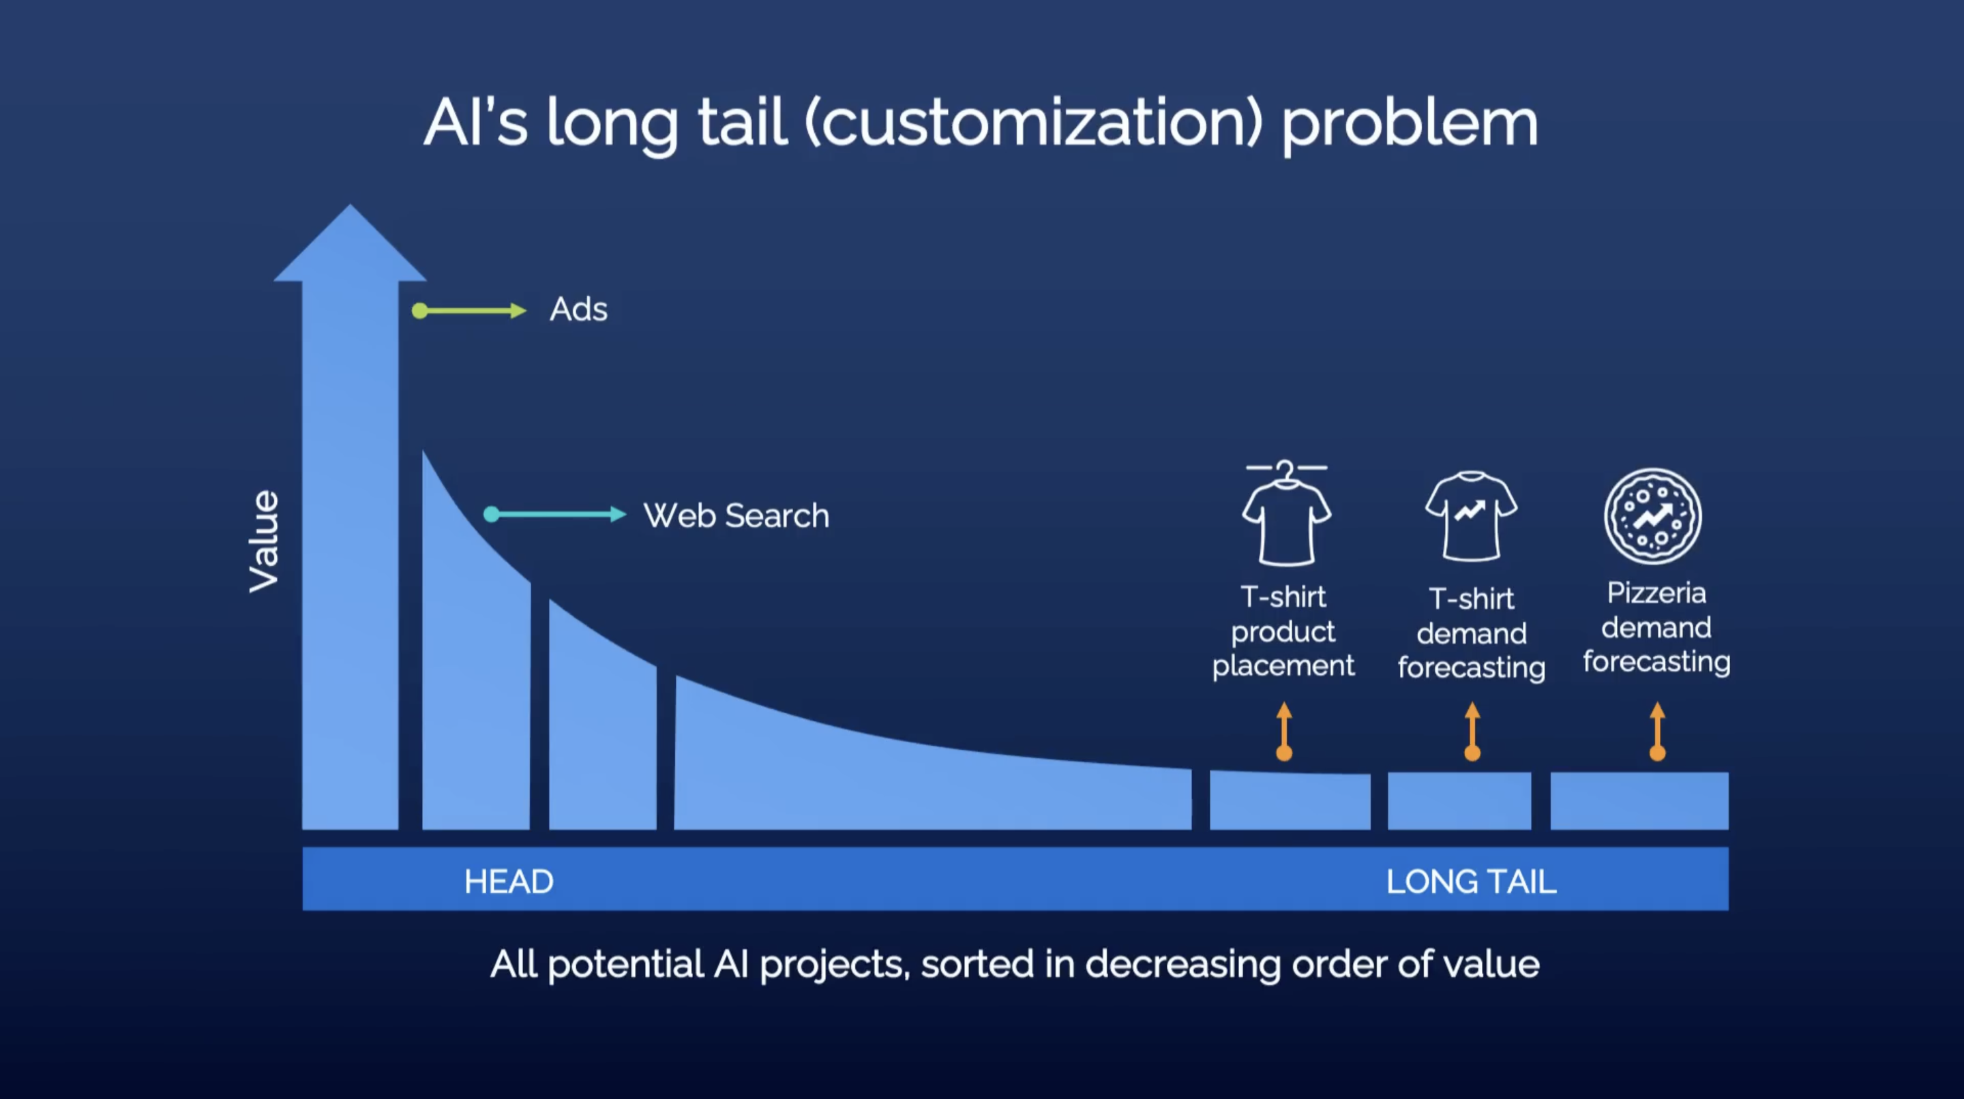
Adaptive AI – 2) Various User Tasks
Andrew Ng TED Talk, 2022 (predates ChatGPT)
Not many working in these areas, but in aggregate represents enormous value.

Slide 9
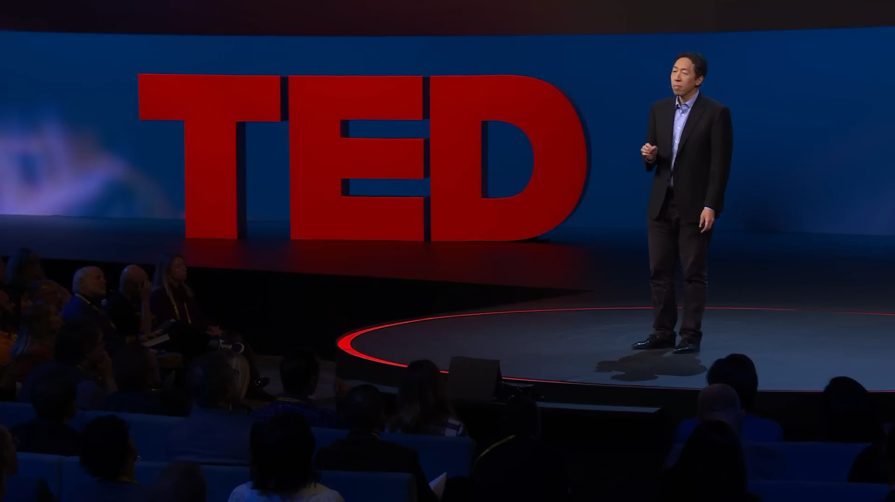
Andrew Ng, TED Talk, 2022 (3 minutes excerpt)

Slide 10
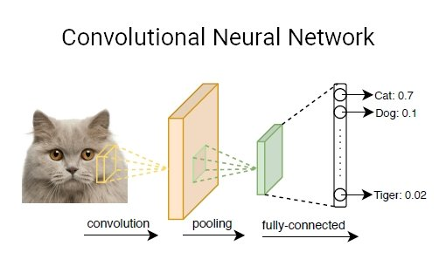
The Long Tail: Narrow AI?
“Narrow AI” refers to machine learning models that are trained for one (narrowly defined) use case
Example:
classify animal in image as cat, dog, …, tiger
If model has never seen a giraffe in training data, it will classify it as any other animal
Thus not very adaptable: each use case requires plenty of training examples. Each new class type needs retraining of model.

Slide 11


Narrow vs. Broad AI
Narrow AI
Specific use cases, high accuracy
Requires many specific data examples
In aggregate very expensive to build as we ned specific data and train a new model for each specific use case
Does not easily adapt to other tasks (but: transfer learning)
Does not easily adapt to another user
If data changes: needs to be retrained
Broad AI
E.g. LLMs, Foundation Models
Generic, huge models (dozens to hundreds billions of parameters)
Emergent capabilities (Wei et al., 2022)
In-context learning / “few shots learners” (Brown et al., 2020)
train-then-fine-tune or prompt-based learning

Slide 12
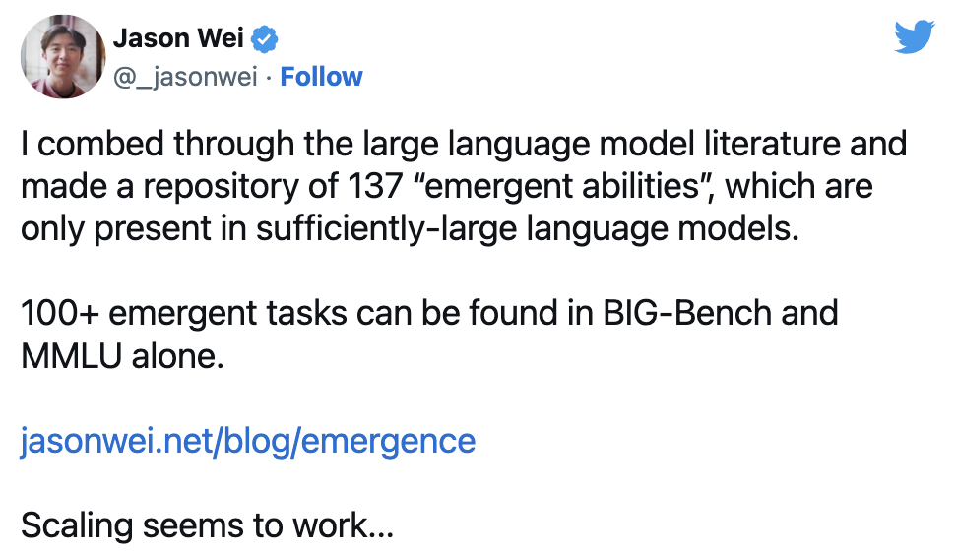
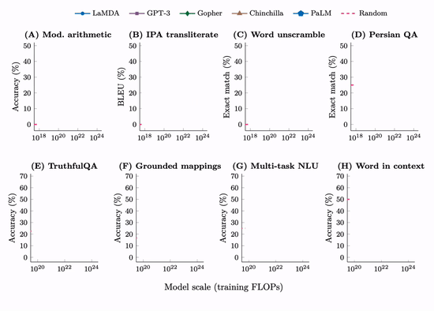
Emergent Abilities
Wei et al. (2022)
Performance of models on many NLP and NLU tasks is only marginally better than random until a certain model size is reached.

Slide 13
The Promise of Broad AI
Train-then-fine-tune
Pre-train large base model (base model for text, base model for image recognition, base model for video sequence analysis, etc.)
Fine-tune model to specific use cases with few examples only
Fine-tune model to specific user with few examples only
Prompt-based learning (see, e.g., Zhou et al., 2023)
user gives an example or two (context)
AI adapts based on example in context
(context in GPT3: 2K tokens, ChatGPT: 4K tokens, GPT4: 8k tokens, GPT4-32K: 32K tokens)

Slide 14
Tokens & Context
Given a text string (e.g., "tiktoken is great!") and an encoding (e.g., "cl100k_base"), a tokenizer can split the text string into a list of tokens: ["t", "ik", "token", " is", " great", "!"]
Source: https://github.com/openai/openai-cookbook/blob/main/examples/How_to_count_tokens_with_tiktoken.ipynb
What to put into the context?
New emerging discipline of “Prompt Engineering”
Users may need to learn completely new strategies such as chain of thought prompting (Wei et al., 2023) and least-to-most prompting (Zhou et al., 2023)

Slide 15

Intermezzo

Slide 16

Adaptive AI: GitHub Copilot
Launched October 2021
AI-powered code completion tool by GitHub & OpenAI
Trained on public code repos on GitHub.com, GitLab.com, etc.
Provides suggestions for line completion and entire function blocks
Learns and adapts to user’s coding style
Aims to increase developer productivity
Provides boilerplate code, avoids errors (bugs), avoids looking up documentation

Slide 17
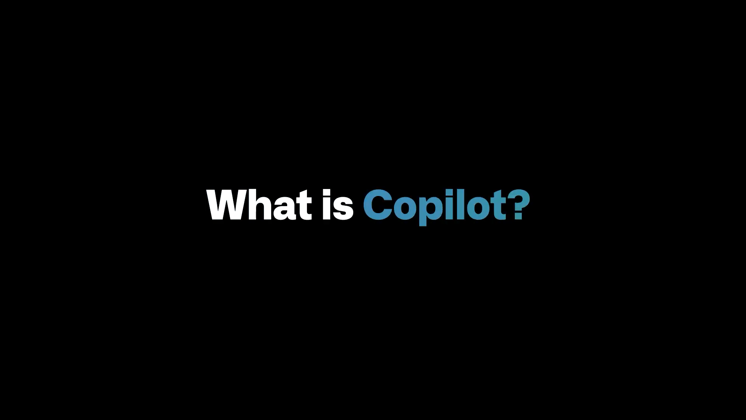
GitHub Copilot, Promotional Video, 2022

Slide 18
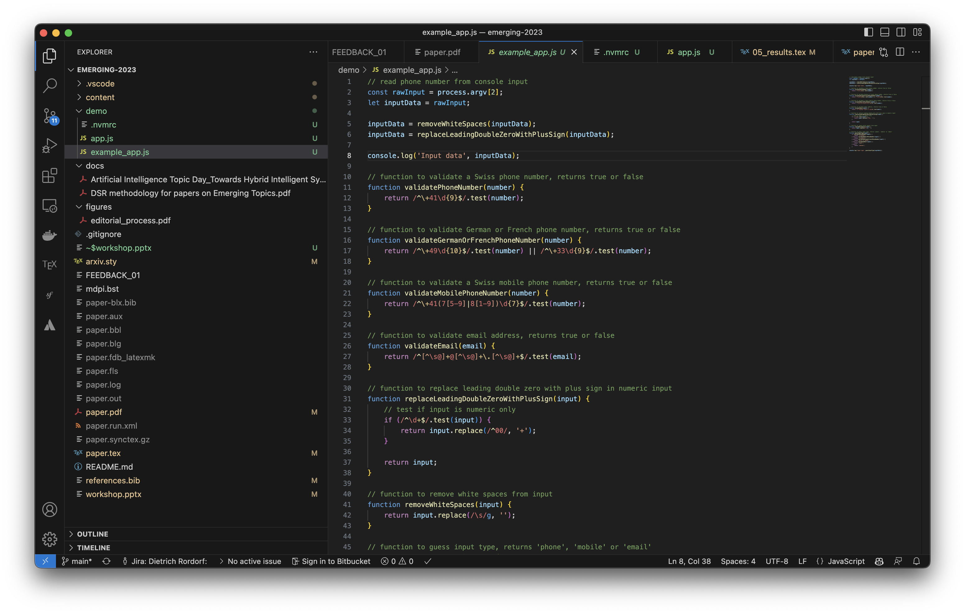

GitHub Copilot Live Demo
😟

Slide 19
Adaptive AI – 3) Joint Task Completion
AI agents need to adapt as part of human-AI teams (Zhao et al., 2022):
to goals and intentions of the human teammates;
to cognitive features of the human;
to physical factors of the human in robot-human interactions (e.g., fatigue of the human); and
adaptation of learned human models to transfer a learned model to interaction with another human.

Slide 20
Adaptive AI – 4) Changing Environment
Societal trends, political or legal changes, etc.
Concept drift: changes to objectives (human set) that AI was designed for
Data drift: changes in the data distribution (Lu et al., 2020)
Requires re-training of AI model to adapt:
Online training: continuous training and redeploy of AI model
Model drift: performance of continuously retrained model degrades over time

Slide 21
Competitive Advantage of AI

Slide 22
Competitive Advantage of AI
Davenport (2018):
AI primarily used by large enterprises, technology companies, AI start-ups
AI capabilities:
robotics and robotic process automation (RPA)
gaining insights from data through machine learning
AI-based engagement with employees, customers through chatbots or intelligent agents
AI can fuel new business models (Iansiti & Lakhani, 2020)

Slide 23
Competitive Advantage of AI
Types of benefits of AI for enterprises (Ho et al., 2022):
reduced costs – e.g., efficiency gains
improved performance – e.g., collect money more quickly
better decision-making – e.g., insights from large amount of data
better customer segmentation, - e.g., more tailored marketing messages
higher customer satisfaction / improved customer experience – e.g., more personalized products, better recommendation, chatbots, etc.
better products & services, e.g., production innovation
business innovation – e.g., new business models

Slide 24
References (1/2)
Akata, Z. et al. (2020). A Research Agenda for Hybrid Intelligence: Augmenting Human Intellect With Collaborative, Adaptive, Responsible, and Explainable Artificial Intelligence. Computer. doi: 10.1109/MC.2020.2996587
Brown, T., et al. (2020). Language Models are Few-Shot Learners. arXiv:2005.14165
Canese, L., et al. (2021). Multi-Agent Reinforcement Learning: A Review of Challenges and Applications. Applied Sciences. doi: 10.3390/app11114948
Davenport, T. (2018). The AI Advantage: How to Put the Artificial Intelligence Revolution to Work. MIT Press. doi: 10.7551/mitpress/11781.001.0001
d’Avila Garcez, A., & Lamb, L. (2023). Neurosymbolic AI: The 3rd wave. Artificial Intelligence Review. doi: 10.1007/s10462-023-10448-w
Ho, L. T., Gan, C., Jin, S., & Le, B. (2022). Artificial Intelligence and Firm Performance: Does Machine Intelligence Shield Firms from Risks? Journal of Risk and Financial Management. doi: 10.3390/jrfm15070302
Iansiti, M., & Lakhani, K. R. (2020). Competing in the Age of AI. Harvard Business Review. https://hbr.org/2020/01/competing-in-the-age-of-ai

Slide 25
References (2/2)
Korteling, J. et al. (2021). Human- versus Artificial Intelligence. Frontiers in Artificial Intelligence. doi: 10.3389/frai.2021.622364
Lu, J., et al. (2020). Data-driven decision support under concept drift in streamed big data. Complex & Intelligent Systems. doi: 10.1007/s40747-019-00124-4
Wei, J., et al. (2022). Emergent Abilities of Large Language Models. arXiv:2206.07682
Wei, J., et al. (2023). Chain-of-Thought Prompting Elicits Reasoning in Large Language Models. arXiv:2201.11903
Zhang, L., et al. (2023). Recommending on graphs: A comprehensive review from a data perspective. User Modeling and User-Adapted Interaction. doi: 10.1007/s11257-023-09359-w
Zhao, M., et al. (2022). The Role of Adaptation in Collective Human–AI Teaming. Topics in Cognitive Science. doi: 10.1111/tops.12633
Zhou, Y., et al. (2023). Revisiting Automated Prompting: Are We Actually Doing Better? arXiv:2304.03609

Slide 26


Slide 27
Group 1 – Writing the manuscript
Group members’ names: David, Milos, Lina, Yannick, Felix, Sandra
Scenario
Web-based platforms for authors to write their manuscript is typically not part of the offering of publishers. Let’s now assume that a publisher would launch a tooling that allows authors to write their papers on the publisher’s platform. The publisher could support authors by deploying adaptive AI tools – similar to GitHub Copilot for coding – to write the scientific manuscript. How and why should the tool be a hybrid AI that adapts to the author? How can it adapt to the author? How would such a system bring a competitive advantage to publishers?
Discuss these and related questions in the group and record key points per type of competitive advantage from the discussion on the next slide (some may be left empty if not applicable). Please help me to generate and understanding of your way of thinking by providing your reasoning and specific comments.
Thank you for your efforts and helping me in this research!
Didi

Slide 28
Group 1 – Writing the manuscript
Results
Reduced costs:
AI can be used to do 1st line of quality control. Less work for reviewers
Improved performance:
Authors are faster at writing papers and therefore publishers can publish more papers
Drafting paragraphs
Better decision-making:
If authors don't have to focus on e.g. sourcing all relevant documents, they can spend their active time with producing real content
Higher customer satisfaction:
Easier writing of paper, no having to search for words
Fatigue not as high if people can concentrate on creating content
Better customer segmentation:
More customers as not only authors for scientific papers will be interested but also students of several age groups
Improved customer experience:
writing and publishing out of one hand
Paper can easily be translated/read in other languages
Faster time to publication
Better products & services:
Can write more papers = more for the publisher to publish
Language and grammar check
Business innovation:
Affordable ghost writing and paper mills
Contextual Knowledge Integration (Integration of Scientific research based on AI tool)

Slide 29
Group 2 – Searching for journal & formatting
Group members’ names: Julia Huilla, Caroline Rüdisühli, Alise Garsina, Lizaveta Kuryla, Corina Stampfli, Larissa Julia, Corina Finsler, Katina Engeler
Scenario
There are 1000s of journals – alone 260 journals contain “information systems” in the title. Imagine you are an author and just finished writing your manuscript. You are now looking at options where you could publish your manuscript. How and why could an adaptive, hybrid AI system support you as the author in recommending suitable journals – considering that you may have specific wishes (may be a journal in information system that accept more technical contributions, or with authors predominantly from DACH region, or a journal published in German. As an author you will typically also be asked to comply with the style of the journal that you chose. How can it adapt to or learn from the author (e.g., history of previous recommendations)? How would such a system bring a competitive advantage to publishers? (think of reformatting the manuscript, if the author was rejected in another journal and now resubmits to your journal)
Discuss these and related questions in the group and record key points per type of competitive advantage from the discussion on the next slide (some may be left empty if not applicable). Please help me to generate and understanding of your way of thinking by providing your reasoning and specific comments.
Thank you for your efforts and helping me in this research!
Didi

Slide 30
Group 2 – Searching for journal & formatting
Results
Reduced costs:
Less rejections
Less editing effort
Improved performance:
Fast feedback on needed adjustments
Time savings because of more suitable applications
Better decision-making:
Rule-based system, which helps to choose a fitting research paper
Higher customer satisfaction:
Reduce workload for authors and editors
Better customer segmentation:
Improved customer experience:
Authors are rejected less/not at all, publishers get most fitting articles
Better products & services:
Better quality/content of papers
Business innovation:
- Matchmaking between publishers and authors

Slide 31
Group 3 – Desk review by editor
Group members’ names: Adelia, Vinojan, Anojan, Leandro, Danijel, Seline
Scenario
As part of desk review, editors are confronted with an increasing number of ethical problems. This could be completely fake (AI generated) papers, authorship issues (adding authors that did not contribute to the manuscript), fabricated images and data, citation to references that are irrelevant to the work, etc. Doing these checks manually is laborious. Yet, automating with narrow AI is difficult as there are only few data examples (there are may be few hundred papers known for each of the ethical cases). How could a hybrid, adaptive AI system support the editor in this task of desk review. To what does the AI need to adapt and why? How would such an adaptive, hybrid AI system contribute to the competitive advantage of the company.
Discuss these and related questions in the group and record key points per type of competitive advantage from the discussion on the next slide (some may be left empty if not applicable). Please help me to generate and understanding of your way of thinking by providing your reasoning and specific comments.
Thank you for your efforts and helping me in this research!
Didi

Slide 32
Group 3 – Desk review by editor
Results https://www.science.org/content/article/what-massive-database-retracted-papers-reveals-about-science-publishing-s-death-penalty
Reduced costs:
Automation of routine checks and tasks reduces the need for extensive manual labor, resulting in cost savings.
Expenses.
Prediction on the step page reviewing.
Improved performance: The AI system's ability to analyze large volumes of data and identify patterns improves the overall performance of the desk review process.
Better decision-making:
AI can recommend keywords to the author
AI can detect patterns that are likely to be AI generated
Higher customer satisfaction:
AI can help with choosing the right journal based on criteria
Better customer segmentation:
The AI system can analyze patterns and indicators within papers, aiding in the identification of potential ethical issues in papers. Adapt to recent literature.
Improved customer experience:
Automation of routine checks speeds up the publication process, reducing waiting times and providing a smoother and more efficient experience for authors.
Better products & services:
AI can create a form of the better review report.
If the paper is rejected because of quality on the stage 7 based on the prediction, then the paper might become better
Business innovation:

Slide 33
Group 4 – Searching for reviewers
Group members’ names: Domenico, Andrea, Luca^2, Nils, Aleksandar (redneck hat guy) & Jonathan
Scenario
Once a manuscript passes desk review, the editors will send it to peer-review. To effectively peer-review a manuscript, the editor will need to find subject experts that have previous experience with the type of research reported in the manuscript. A hybrid, adaptive AI system could be employed to recommend suitable reviewers. The editor may have additional rules for the selection of candidate reviewers (i.e., rules engineering or symbolic AI). How could a hybrid AI combine sub-symbolic (e.g., word embeddings in vector space) and symbolic approaches (rules), and how does such a system need to adapt? Hints: think of ca. November 2019 and early 2020 when the pandemic hit. Think of someone retiring. Think of a user that rejects certain recommendations. How would such a system help the company to gain a competitive advantage?
Discuss these and related questions in the group and record key points per type of competitive advantage from the discussion on the next slide (some may be left empty if not applicable). Please help me to generate and understanding of your way of thinking by providing your reasoning and specific comments.
Thank you for your efforts and helping me in this research!
Didi

Slide 34
Group 4 – Searching for reviewers
Results
Reduced costs:
- Manual work time of employees
Improved performance:
(up-to-date data base)
Faster
All possible reviewers evaluated regarding expertise
More effective distribution
Fast change (exclude retired person)
Better decision-making:
- (Comprehensiveness in information ensured)
Higher customer satisfaction:
Better customer segmentation:
Improved customer experience:
- Immediate response
Better products & services:
No or fewer conflicts of interest
Better quality of final result
Unbiased match-making
Measure performance of reviewers
Business innovation:
You can add it as a ad-on feature to subscription

